Slide 1

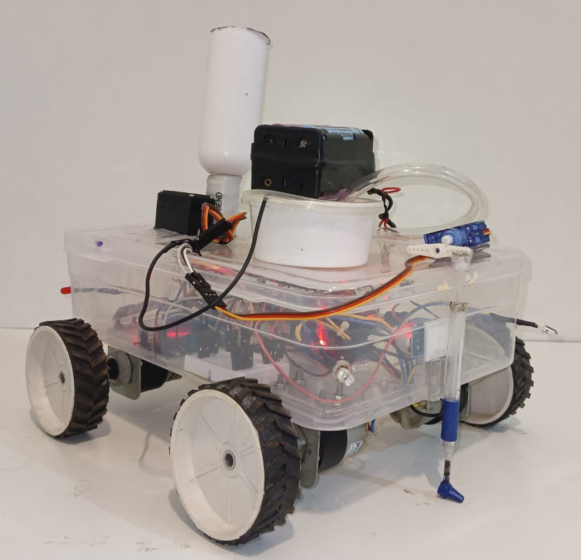
Automatic Seed Sowing and Spraying Agriculture Robot
Names :Chandrashekhar Bhavi , Jamuna Pulpatali, Priyanka Budihal, Pruthviraj Banoshi
Under guidance of : Dr. Prabhakar Manage
Department of Electronics and Communication Engineering
Problem statement
Results
Optimization details
Develop an automatic seed sowing and spraying agriculture robot to enhance efficiency , reduce labour dependency , and ensure precise seed placement for smart farming
Connectivity: Upgrade from Bluetooth for wider control range.
Terrain Adaptability: Add adjustable suspension or terrain-following mechanism for uneven fields.
Seed Dispensing: Use interchangeable drums for different seed sizes to ensure uniform placement.
Modular Design: Use detachable parts for easy maintenance and customization.
Objectives
Reduce Human Labor
Improve Productivity
Enhance Affordability
Increase Efficiency
Contributions
Conclusions
.
Integrated Automation: Combines sowing, covering, and watering.
Low-Cost & Easy Control: Affordable with Bluetooth-based mobile operation.
Precise & Scalable: Accurate seed placement, modular, and solar-ready.
The autonomous seed sowing robot streamlines farming by combining soil digging, seed sowing, covering, and watering into one efficient system. It showed accurate seed placement, consistent coverage, and effective watering during tests. The Bluetooth-based control enabled real-time adjustments for different crop needs. While challenges like uneven terrain, varying seed sizes, and limited control range remain, the robot offers a promising solution to labor shortages and inefficiencies. With improvements in terrain handling, connectivity, and navigation, it could significantly boost productivity and support sustainable agriculture.
The autonomous seed sowing robot was designed to simplify and enhance the efficiency of agricultural processes by automating critical tasks like soil digging, seed sowing, soil covering, and water spraying. After completing the fabrication and assembly of the robot, extensive testing was conducted under controlled and field conditions to evaluate its performance. The results demonstrated the robot's capability to execute its functions accurately, and the discussion highlights the successes, challenges, and potential for further improvements.
Literature survey
Automatic Seed Sowing and Spraying Agriculture Robot
Agribot : Arduino Controlled Automatic Seed Sowing Machine for Small Scale Cultivation
Design and fabrication of manually operated seed sowing machine
Automatic Seed Sowing Robot
Minor Project-2024-25

